Slide 1

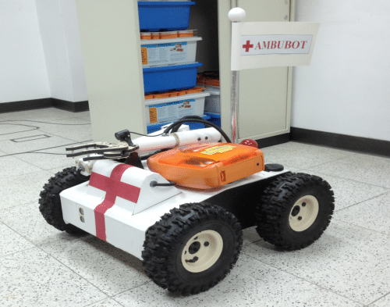
Presentation
Benedetti Lorenzo
Academic year 2021-2022
1

Slide 2

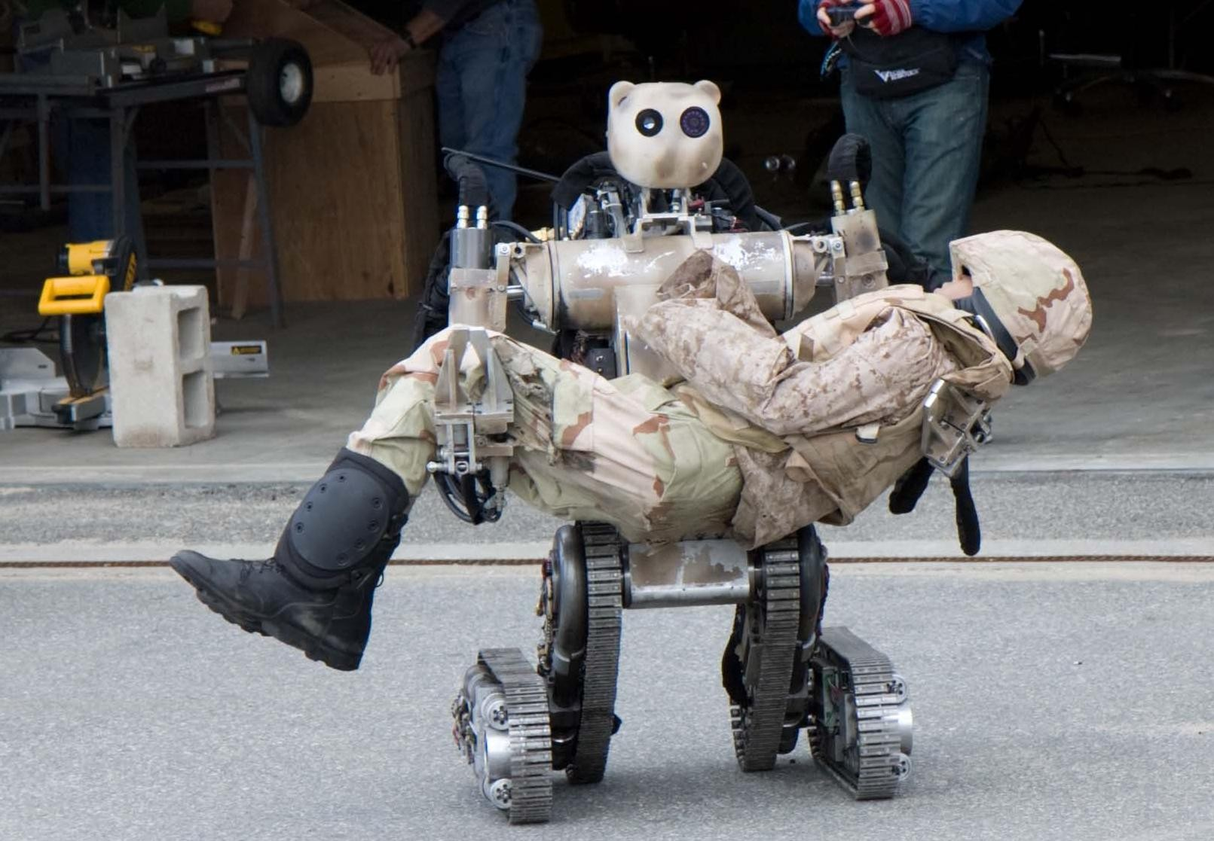
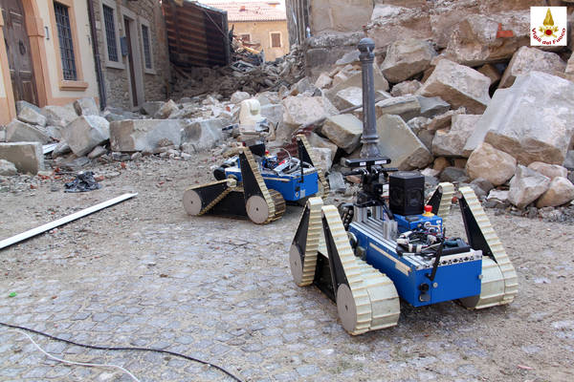
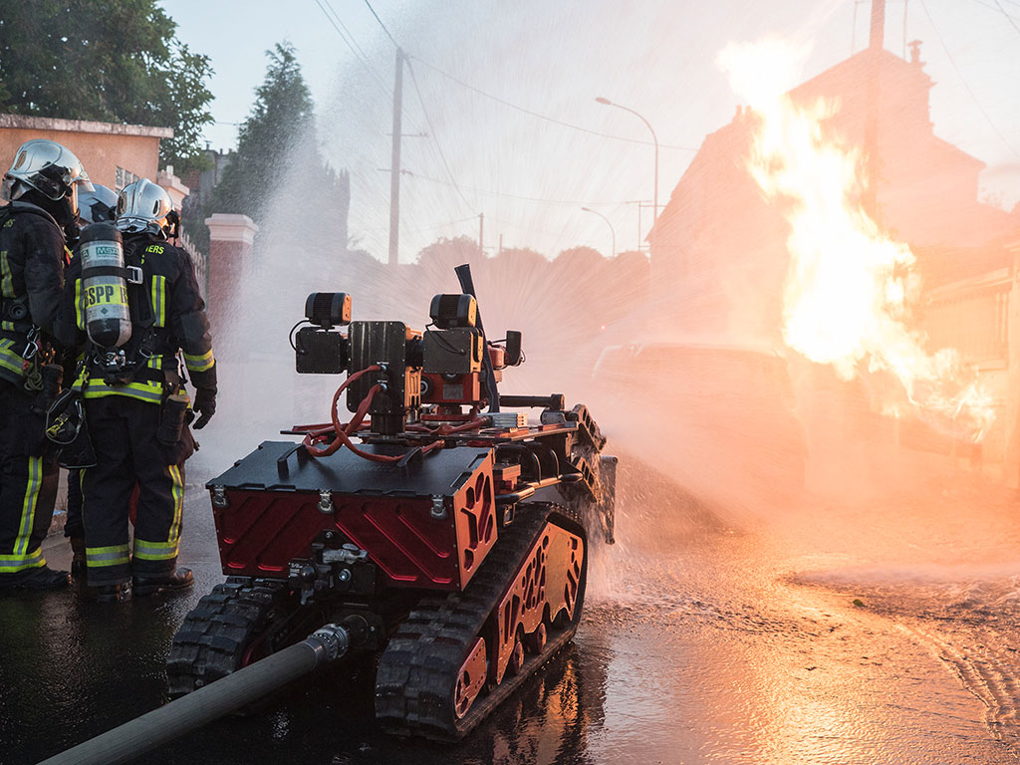
Introduction
Robotic systems are one of the key solution for providing smart services in future smart cities
AmbuBot, a mobile robot that brings along an AED to help lay rescuers for saving patients life in a sudden event of cardiac arrest.

Slide 3
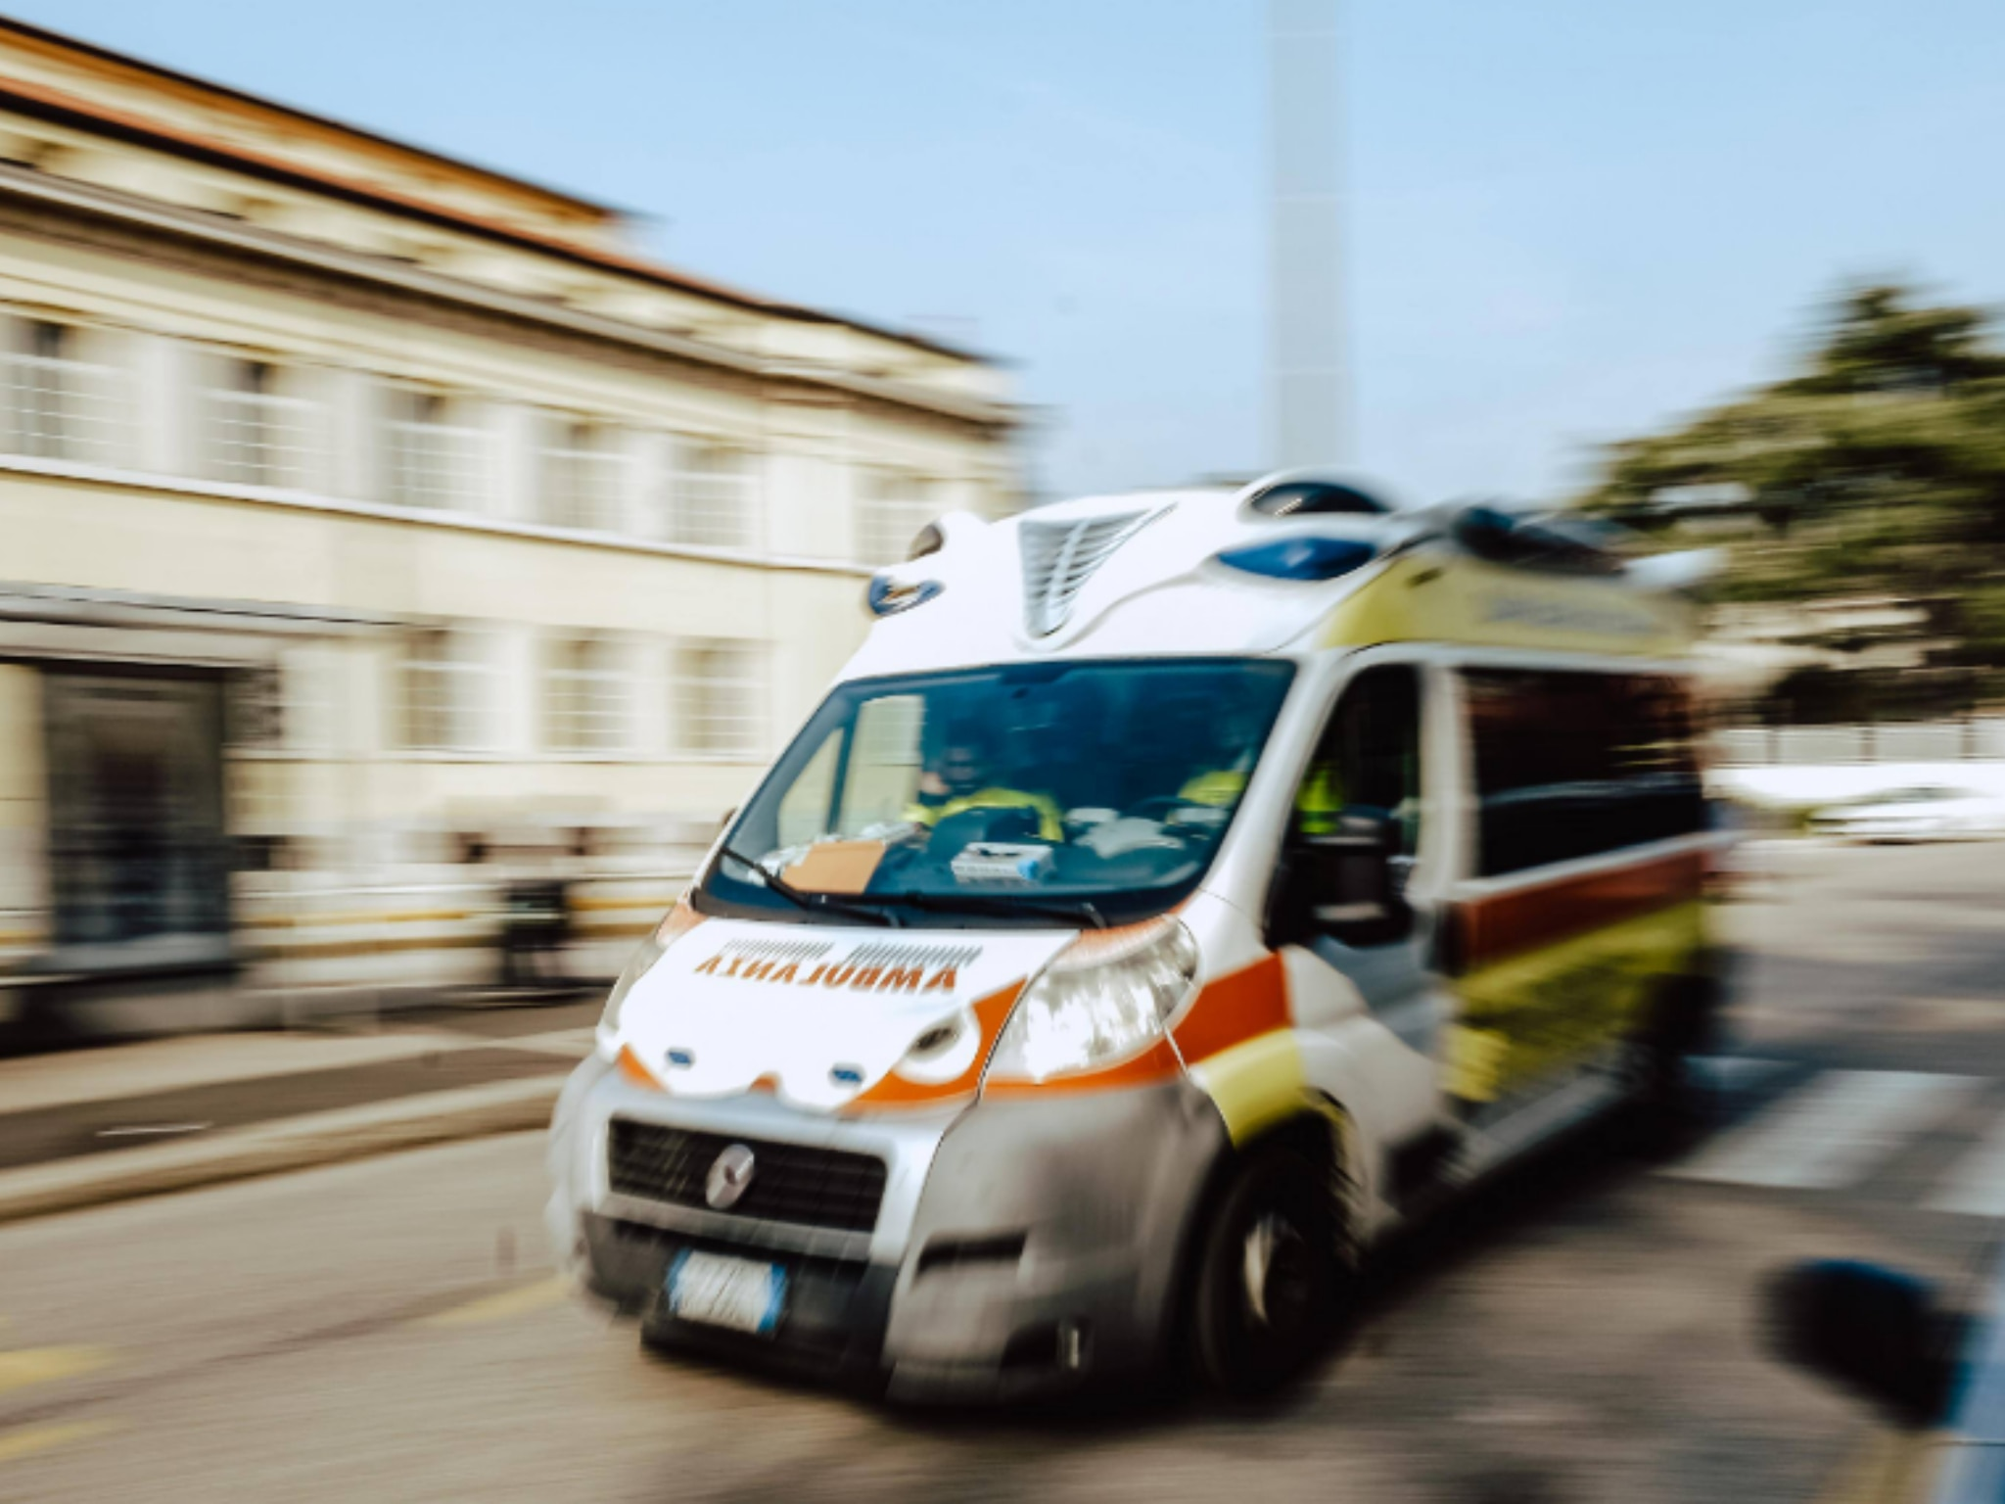
What to do if a sudden cardiac arrest happen?
Cardiac arrest
First panic
Dispatch of ambulances
Sudden cardiac arrest is one of the major causes of mortality in both men and women
it is difficult for people to locate AEDs in an emergency. It is because of the first panic that arises in such cases.
An ambulance is usually dispatched to the spot within ten minutes or more, often too much time to save a life.

Slide 4
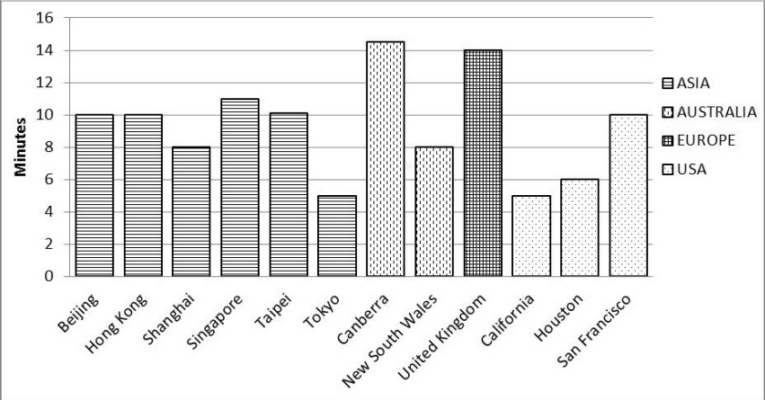
Problems in big cities
In the case of health emergency situation, it is common to call the emergency hotline to seek for assistance which often the ambulance will be dispatched to the scene in average of ten minutes time.
A variety of circumstances influence this issue, including traffic congestion, difficulties locating the location, lengthy distance, and so on.

Slide 5
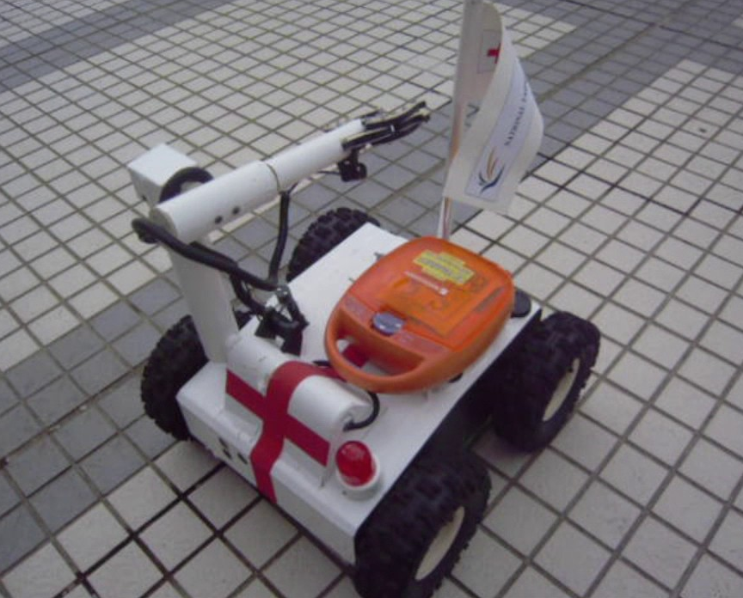
ambubot
Simple mobile robot.
Good agility in both indoor and outdoor environments.
Gripper that can pick up things below 10 kg of weight.
Two videocameras for human-robot coordination.
Speed of 10 km/h.
Climb slopes up to 45 degrees.

Slide 6
There are two methods for keeping cardiac arrest sufferers alive: a body-attached sensor or a mobile phone application. Then :
A warning message is sent out and the AmbuBot center will receive GPS data.
A GPS and a GIS parser will transform the longitude and latitude coordinates into a street map position.
AmbuBot center will generate two commands:
One to dispatch AmbuBot from the station to the scene.
Another to deliver an emergency message to family members via GMSC.
It is important notifying the nearest hospital’s ambulance when the situation is confirmed.

Slide 7
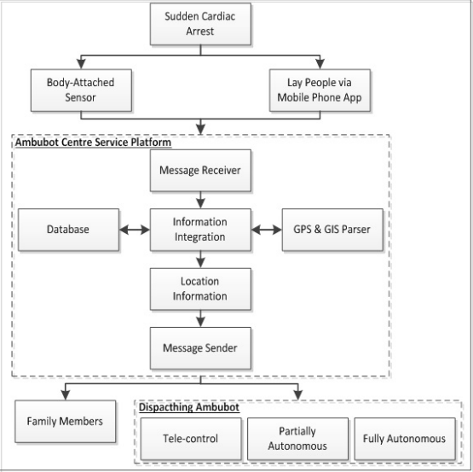

Slide 8

Dispatching ambubot
AmbuBot can be dispatched in a variety of modes, including partially autonomous, fully autonomous and tele-control.
8

Slide 9
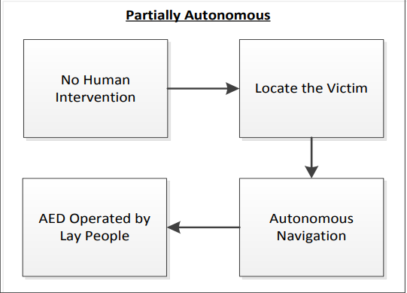
Partially autonomous
Human operators should assist in adapting task processes to the actual world to complete the mission reliably.
AmbuBot is now in autonomous navigation and obstacle avoidance mode.

Slide 10
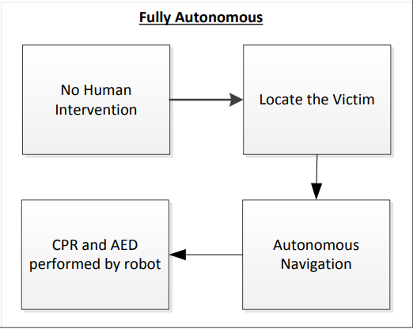
Fully autonomous
AmbuBot can accomplish required activities without constant human guidance in this mode.
Ambu-bot performs AED on its own without constant human supervision.

Slide 11
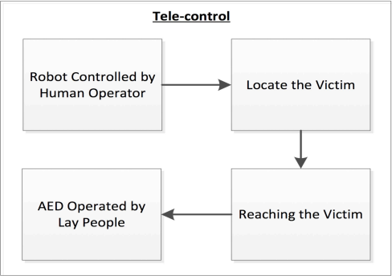
Tele-control
Tele-control uses a visual display and a control pad to help the human operator in navigating the AmbuBot
Human operators will give precise instructions to the victims.
This is the main modality through which AmbuBot is dispatched.

Slide 12
Ambubot loop
The Control module
The AmbuBot loop may be divided into three modules:
The accelerometer and gyroscope create pitch and roll estimations
The compass generates yaw estimation.
EKF’s two correction stages:
The first used data from the accelerometer to correct the system state
The second used data from the magnetic compass to adjust the angular position.
Extended Kalman Filter as a sensor fusion method and a quaternion to represent angular position data throughout system modeling and design.
The Observation module
The estimating module utilizing EKF.

Slide 13
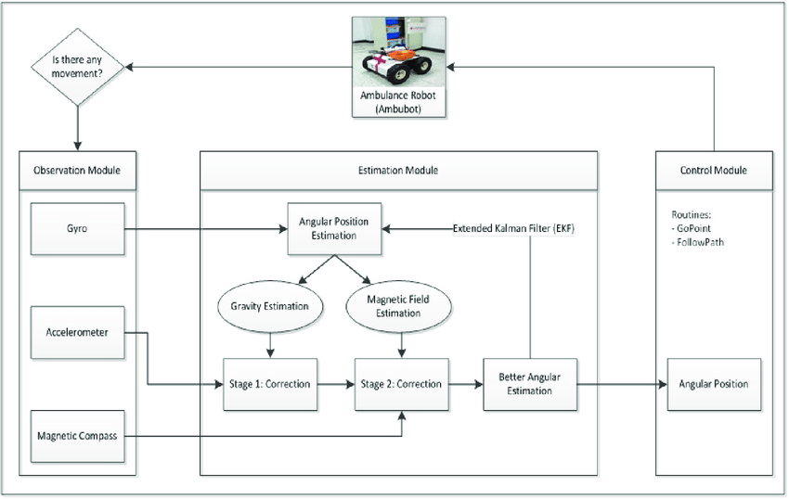
Ambubot loop

Slide 14

Future ideas
AmbuBot must make its own decisions based on external conditions while being guided by the user.
AmbuBot must be completely autonomous, capable of face every obstacles and of applying the AED alone
Flying drone in collaboration with AmbuBot for quicker performance and operation at greater heights.

Slide 15

Conclusion
AmbuBot helps to overcome the obstacles that people can face during a cardiac arrest, such as not finding the AED due to panicking, the scarcity of AEDs in the surroundings and so on.
Simple system to use.
The robot would be able to pass through all road junctions without stopping.
It can be used in a variety of methods to locate and save victims.

Slide 16
references
[AS14] Mohammad Arif and Hooman Samani. “AMBUBOT: Ambulance robot automated external defibrillator robotic ambulance”. In: Proc. 16th Int. Conf. Adv. Commun. Technol.(ICACT). 2014, pp. 58–66.
[SZ16] Hooman Samani and Rongbo Zhu. “Robotic Automated External Defibrillator Ambulance for Emergency Medical Service in Smart Cities”. In: IEEE Access 4 (2016), pp. 268– 283. doi: 10.1109/ACCESS.2016.2514263.
[Gaj17] Mr M Gajendiran. “AN AUTOMATED EXTERNAL DEFIBRILLATOR IN ROBOTIC AMBULANCE (AMBUBOT)”. In: (2017).
[GS18] Somashekhar GC and SS Shivaranjani. “Multipurpose Ambubot for Disaster Management to Assist The People from Cardiac Arrest”. In: Journal for Research— Volume 4.02 (2018).
[KP18] Gayana J Kumar and MC Padma. “Robotic Ambulance for Medical Emergency Using Microcontroller and Sensor”. In: (2018).
[JAI+19] M JAIGANESH et al. “AMBUBOT REPLACING AMBULANCES FOR EMERGENCY”. In: (2019).
[Roh+] S Rohini et al. “AN AUTOMATED EXTERNAL DEFIBRILLATOR IN ROBOTICS AMBULANCE”. In: ().

Slide 17
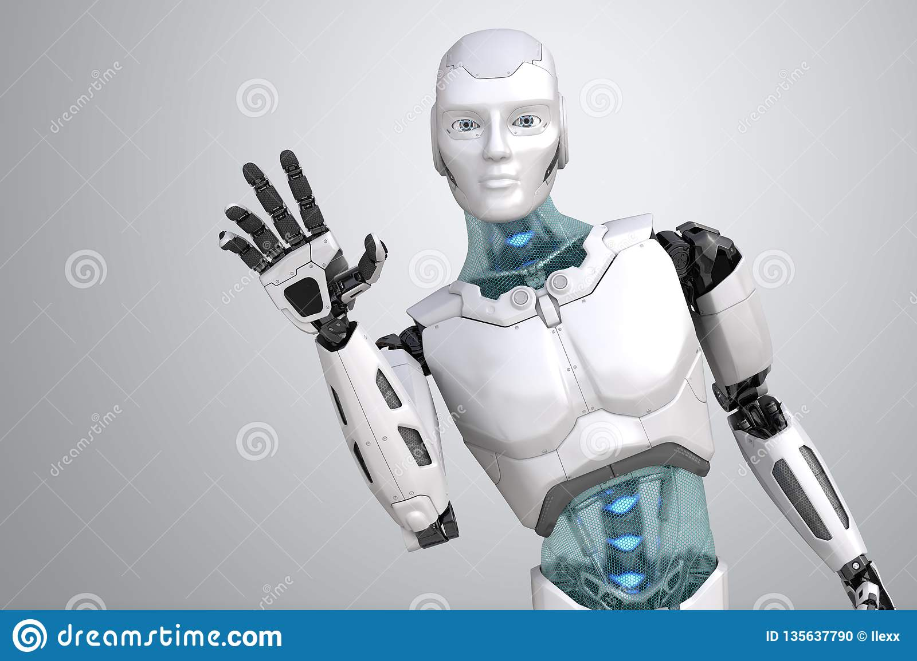
Thank you!

